Slide 1
Cornerstone City Church Peninsula Plus Community Hoo Are Ya
5th October 2025

Slide 2
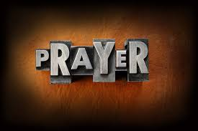

Slide 3
He Lives
CCLI Song # 7133098
Anthony Skinner | Chris McClarney | Jonathan Smith
© 2020 Capitol CMG Genesis; Be Essential Songs; Cashagamble Jet Music; Bethel Music Publishing SESAC; Thirsty Boots Music
For use solely with the SongSelect® Terms of Use. All rights reserved. www.ccli.com

Slide 4
1/7
See the tomb where He laid
See the stone rolled away
He is risen He is risen He's alive
See His hands see His feet
Touch His scars and believe
He is risen He is risen He's alive
Oh He's alive

Slide 5
2/7
He lives
All honor and power are His
All glory forever amen
Jesus (lives)
(Jesus lives)

Slide 6
3/7
Hear the shackles breaking free
Hear the song of the redeemed
He is moving He is moving He's alive
So take this freedom take this love
Can you feel it rising up
He is here He is here He's alive

Slide 7
4/7
He lives
All honor and power are His
All glory forever amen
Jesus (lives)
(Jesus lives)

Slide 8
5/7
You took all our shame
Left it in the grave
We're forgiven we're forgiven
The work forever done
Only by the blood
It is finished it is finished

Slide 9
6/7
He lives
All honor and power are His
All glory forever amen
Jesus (lives)
(Jesus lives)

Slide 10
7/7
He is risen He is risen He's alive

Slide 11
Lord I lift Your Name On High
CCLI Song # 117947
Rick Founds
© 1989 Universal Music - Brentwood Benson Publishing
For use solely with the SongSelect® Terms of Use. All rights reserved. www.ccli.com
CCLI Licence No. 33265

Slide 12
1/2
Verse
Lord I lift Your name on high
Lord I love to sing Your praises
I'm so glad You're in my life
I'm so glad You came to save us

Slide 13
2/2
Chorus
You came from heaven to earth
To show the way
From the earth to the cross
My debt to pay
From the cross to the grave
From the grave to the sky
Lord I lift Your name on high

Slide 14
Great Are You Lord
CCLI Song # 6460220
David Leonard | Jason Ingram | Leslie Jordan
© 2012 Open Hands Music (Admin. by Essential Music Publishing LLC)
So Essential Tunes (Admin. by Essential Music Publishing LLC)
Integrity's Praise! Music (Admin. by Integrity Music Ltd)
Little Way Creative (Admin. by Integrity Music Ltd)
For use solely with the SongSelect® Terms of Use. All rights reserved. www.ccli.com
CCLI Licence No. 33265

Slide 15
1/3
You give life You are love
You bring light to the darkness
You give hope You restore ev'ry heart that is broken
And great are You Lord

Slide 16
2/3
It's Your breath in our lungs
So we pour out our praise
We pour out our praise
It's Your breath in our lungs
So we pour out our praise to You only

Slide 17
3/3
And all the earth will shout Your praise
Our hearts will cry these bones will sing
Great are You Lord
(REPEAT)

Slide 19
Firm Foundation (He Won't)
CCLI Song # 7188203
Austin Davis | Chandler Moore | Cody Carnes
© 2021 For Humans Publishing (Admin by Essential Music Publishing)
Maverick City Publishing (Admin by Essential Music Publishing)
Capitol CMG Paragon (Admin. by Capitol CMG Publishing)
TBCO Publishing (Admin. by Capitol CMG Publishing)
Writer's Roof Publishing (Admin. by Capitol CMG Publishing)
A.L.K.D. Music (Admin. by Watershed Music Group (Admin. by Capitol CMG Publishing))
For use solely with the SongSelect® Terms of Use. All rights reserved. www.ccli.com
CCLI Licence No. 33265

Slide 20
1/11
Christ is my firm foundation
The rock on which I stand
When everything around me is shaken
I've never been more glad

Slide 21
2/11
That I put my faith in Jesus
'Cause He's never let me down
He's faithful through generations
So why would He fail now

Slide 22
3/11
He won’t
He won't

Slide 23
4/11
I've still got joy in chaos
I've got peace that makes no sense
So I won't be going under
I'm not held by my own strength

Slide 24
5/11
'Cause I've built my life on Jesus
He's never let me down
He's faithful in every season
So why would He fail now

Slide 25
6/11
He won’t He won't
He won't fail
He won't fail

Slide 26
7/11
Rain came and wind blew
My house was built on You
I'm safe with You
I'm going to make it through

Slide 27
8/11
I'm going to make it through
‘Cause I’m standing strong on You
I’m going to make it through
‘Cause my house is built on You

Slide 28
9/11
Christ is my firm foundation
The rock on which I stand
When everything around me is shaken
I've never been more glad

Slide 29
10/11
That I put my faith in Jesus
'Cause He's never let me down
He's faithful through generations
So why would He fail now

Slide 30
11/11
He won’t He won't
He won't fail
He won't fail

Slide 31
Good Good Father
CCLI Song # 7036612
Anthony Brown | Pat Barrett
© 2014 Capitol CMG Paragon (Admin. by Capitol CMG Publishing)
Common Hymnal Digital (Admin. by Capitol CMG Publishing)
Housefires Sounds (Admin. by Capitol CMG Publishing)
Rising Springs Music (Admin. by Capitol CMG Publishing)
Tony Brown Publishing Designee (Admin. by Capitol CMG Publishing)
Vamos Publishing (Admin. by Capitol CMG Publishing)
worshiptogether.com songs (Admin. by Capitol CMG Publishing)
For use solely with the SongSelect® Terms of Use. All rights reserved. www.ccli.com
CCLI Licence No. 33265

Slide 32
1/7
I've heard a thousand stories
Of what they think You’re like
But I've heard the tender whisper
Of love in the dead of night
You tell me that You’re pleased
And that I'm never alone

Slide 33
2/7
You're a Good Good Father
It's who You are
It's who You are
It's who You are
And I'm loved by You
It's who I am
It's who I am
It's who I am

Slide 34
3/7
I've seen many searching for answers
Far and wide
But I know we're all searching for answers
Only You provide
Because You know just what we need
Before we say a word

Slide 35
4/7
You're a Good Good Father
It's who You are
It's who You are
It's who You are
And I'm loved by You
It's who I am
It's who I am
It's who I am

Slide 36
5/7
You are perfect in all of Your ways
You are perfect in all of Your ways
You are perfect in all of Your ways to us

Slide 37
6/7
Love so undeniable I can hardly speak
Peace so unexplainable I can hardly think
As You call me deeper still
As You call me deeper still
As You call me deeper still
Into love love love

Slide 38
7/7
You're a Good Good Father
It's who You are
It's who You are
It's who You are
And I'm loved by You
It's who I am
It's who I am
It's who I am

Slide 40


Slide 42

Grow Group 1
On YOUR MARK!

Slide 43
Leaders
Leaderss
Phil & Kim
Maria (Mia) Warren
Matthew Harrison
Richard & Elisha Acheampong
Phil & Kim
Maria (Mia) Warren
Matthew Harrison
Richard & Elisa Acheampong

Slide 44
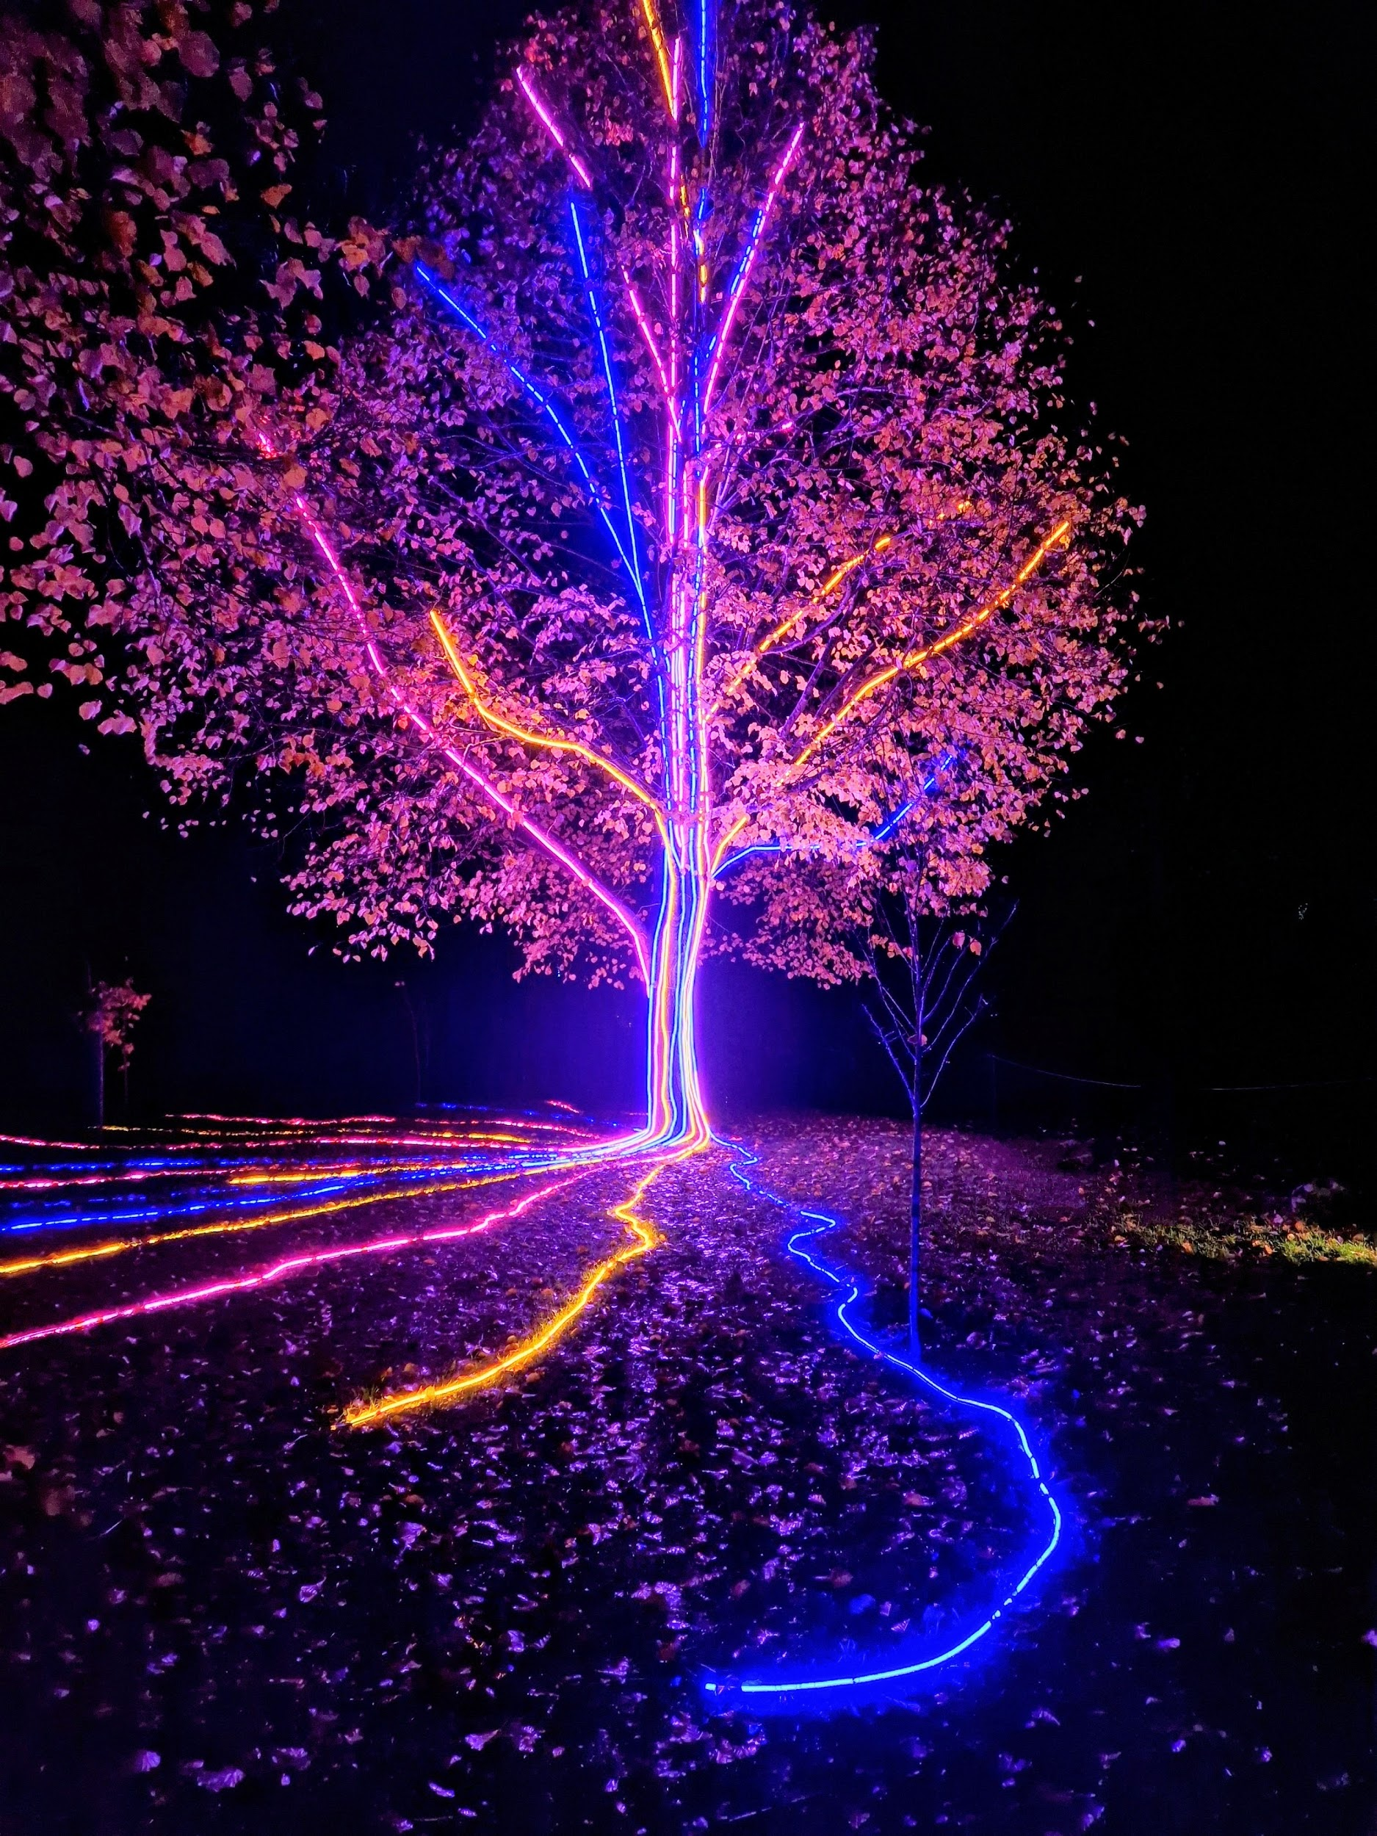
Storm Walker
Storm Walker
Symbolising, trust in Jesus Christ through life's storms.
Mark 4:35-41

Slide 45



Group Leaders
Micheal and Mwamba
Wilfred and Parveen
Hannah

Slide 46


Slide 47


Slide 48
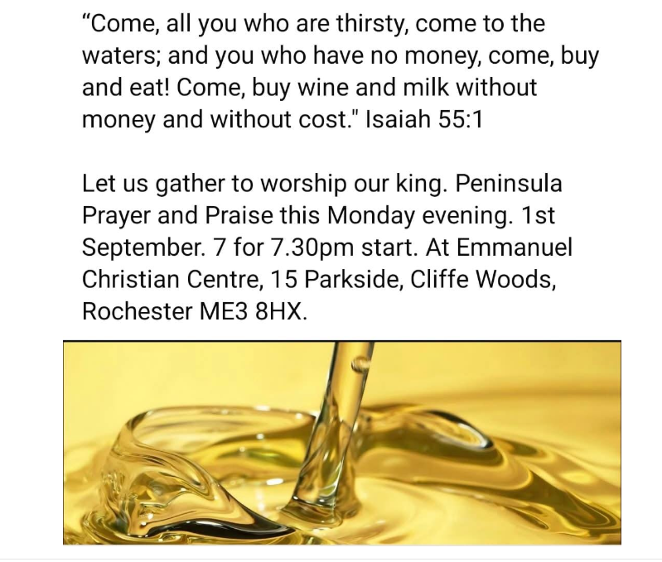

Slide 49


Slide 50
Behold Him
CCLI Song # 7133698
Mitch Wong | Paul Baloche
© 2019 A Wong Made Write Publishing; Integrity Worship Music; Integrity's Praise! Music; Leadworship Songs
For use solely with the SongSelect® Terms of Use. All rights reserved. www.ccli.com

Slide 51
1/7
He who was before there was light
Walked across the pages of time
He who made every living thing
Behold Him
He who heard humanity's cry
Left His throne to wake as a child
He became like the least of us
Behold Him

Slide 52
2/7
Jesus Son of God Messiah
The Lamb the roaring Lion
Oh be still and behold Him

Slide 53
3/7
He who dined with sinners and saints
Healed the blind the lost and the lame
Even now He is in our midst
Behold Him
He who chose a criminal's end
Paid with blood to settle our debt
Buried death as He rose to life
Behold Him

Slide 54
4/7
Jesus Son of God Messiah
The Lamb the roaring Lion
Oh be still and behold Him
Jesus Alpha and Omega
Our God the risen Savior
Oh be still and behold Him

Slide 55
5/7
Holy holy holy
Is the Lord God Almighty
Worthy worthy worthy
To receive all praise (REPEAT)

Slide 56
6/7
Jesus Son of God Messiah
The Lamb the roaring Lion
Oh be still and behold Him
Jesus Alpha and Omega
Our God the risen Savior
Oh be still and behold Him

Slide 57
7/7
Behold Him

Slide 58
2 Corinthians 14 May the grace of the Lord Jesus Christ, and the love of God, and the fellowship of the Holy Spirit be with you all
Surely goodness and mercy shall follow us all the days of our lives, and we shall dwell in the house of the Lord forever.

